Slide 1
Employee’s Performance for HR Analytics
By: Isa Abdulla

Slide 2


Employee’s Performance
HR
Analytics
Through HR analytics, organizations can use data to understand performance drivers, improve productivity, and support better decision-making.
Introduction

Slide 3

Problem Statement
Employee performance is one of the most important factors in an organization’s success. However, many companies struggle to identify which factors truly drive high performance, engagement, and retention. By applying HR analytics, organizations can move away from intuition-based decisions and toward evidence-based workforce strategies.

Slide 4
Audience
HR
leaders
Organizational decision-makers
Managers
Executives
Business leaders
4
Page

Slide 5

Key Performance Indicators (KPIs):
KPIs are measurable targets that show whether an employee is meeting their performance goals. In this dataset, KPI success means the employee achieved more than 80% of their performance target.
For example:
In Sales, a KPI could be meeting monthly sales revenue.
In Customer Service, it could be achieving a high customer satisfaction score.
In HR, a KPI might be reducing time-to-hire or increasing employee retention.

Slide 6





Total Employees: 17417
Gender Distribution: {'m': 70.7%, 'f': 29.3%}
Education Levels: {'Bachelors': 70.6%, 'Masters & above': 27.8%, 'Below Secondary': 1.6%}
Average Age: 35
Met KPIs: 36 %
• Average Training Score: 63.2 /100
Top 3 Departments: {'Sales & Marketing': 5458, 'Operations': 3524, 'Procurement': 2240}
Average Length of Service: 5.8 years
+126
Monitoring
Dataset Overview
Total Employees
Average Age
17417
35
Met KPIs
Average Training Score
Average Length of Service
36%
63.2
5.8
/100
years
Enterprise Analytics empowers organizations to transform data into actionable intelligence. By integrating advanced analytics across departments, businesses can make better decisions, enhance efficiency, and unlock hidden opportunities.
90%
$367,000+

Slide 7


Total Employees: 17417
Gender Distribution: {'m': 70.7%, 'f': 29.3%}
Education Levels: {'Bachelors': 70.6%, 'Masters & above': 27.8%, 'Below Secondary': 1.6%}
Average Age: 35
Met KPIs: 36 %
• Average Training Score: 63.2 /100
Top 3 Departments: {'Sales & Marketing': 5458, 'Operations': 3524, 'Procurement': 2240}
Average Length of Service: 5.8 years
+126
Monitoring
Dataset Overview
Gender Distribution
Education levels
Top 3 Departments
70.7%
Sales & Marketing
70.6%
5458
Male
Bachelors
29.3%
Operations
27.8%
3524
Female
Masters
& above
Procurement
1.6%
2240
Below
Secondary
36%
Enterprise Analytics empowers organizations to transform data into actionable intelligence. By integrating advanced analytics across departments, businesses can make better decisions, enhance efficiency, and unlock hidden opportunities.
90%
$367,000+

Slide 8




Identify Key Factors Influencing Performance
Evaluate Training Effectiveness
Assess Workforce Demographics & Diversity
Provide Actionable Insights for HR Strategy
Goals
8
Page

Slide 9
identify the key factors that influence employee performance.
examine the relationship between employee training and KPI achievement.
analyze the impact of demographic factors (such as age, education, and tenure) on employee performance.
compare performance levels across different departments within the organization.
assess how recruitment channels are related to employee performance.
evaluate the overall distribution of KPI achievement among employees.
Training Effectiveness by Department.
Gender & Department Distribution.
Objectives
Identify the key factors that influence employee performance.
Examine the relationship between employee training and KPI achievement.
Analyze the impact of demographic factors (such as age, gender , education, and tenure) on employee performance.
Compare performance levels across different departments within the organization.
Assess how recruitment channels are related to employee performance.
Evaluate the overall distribution of KPI achievement among employees.
Provide Data-Driven Recommendations

Slide 10
KPI Success by Training Score Category

Slide 11
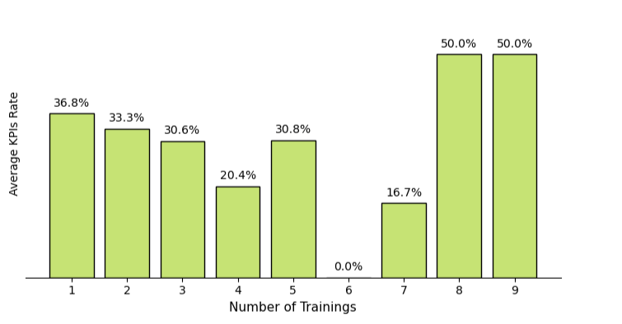
KPI Success by Number of Trainings Taken
KPI Success % by Number of Trainings Taken

Slide 12
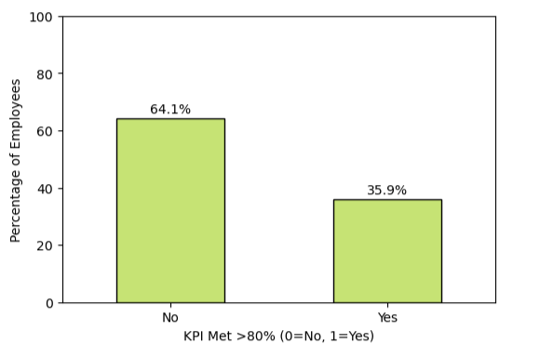
Overall KPI Distribution

Slide 13
KPI Success by Previous Year Rating

Slide 14
KPI Success by Age Category

Slide 15
KPI Success by Gender

Slide 16
KPI Success by Education Level

Slide 17
Gender & Department Distribution

Slide 18
KPI by Department Performance

Slide 19
Training Effectiveness by Department
Training Effectiveness by Department

Slide 20
Recruitment Channels & KPI

Slide 21
KPI Success by Award Won

Slide 22
KPI Success by Length of Service Category

Slide 23
Conclusion
Employee performance is the key driver of organizational success.
Our analysis shows that employee performance is strongly influenced by training , recognition, and past ratings.
Mid-tenure employees and high-training departments perform best, while overall only one-third of employees meet KPIs.
HR should focus on improving training, expanding recognition, and addressing diversity gaps to close the performance gap and drive organizational success.”

Slide 24
Recommendations
Enhance KPI Performance Through Training Participation
Encourage employees to participate in more training programs, as increased training programs are strongly linked to higher KPI achievement rates.
Strengthen Support Across Career Stages
Provide re-engagement opportunities for experienced and long tenure employees and monitoring the new hired & mid-tenure employees to maintain productivity.
Close the Gender Representation Gap
While KPI success is similar for men and women, some departments are male-dominated. HR should encourage more balanced hiring and promotion practices.
Leverage High-Performing Departments as Benchmarks
Analytics and Research and Development departments show both high training scores and KPI achievement. Their practices can be modeled across other teams to raise performance standards company-wide.
Recommendations
Focus on Training Quality, Not Quantity Expand Recognition Programs Awards and promotions are strongly tied to performance, but currently limited to a small percentage of employees. Broaden recognition to motivate a larger share of staff.
Strengthen Support Across Career Stages Provide strong onboarding and mentoring for new hires (0–2 years), and re-engagement opportunities for long-tenured employees to maintain productivity.
Close the Gender Representation Gap While KPI success is similar for men and women, some departments are male-dominated. HR should encourage more balanced hiring and promotion practices.
Leverage High-Performing Departments as Benchmarks Technology and Operations show both high training scores and KPI achievement. Their practices can be modeled across other teams to raise performance standards company-wide.

Slide 25
Thank
You!

